Slide 1
Airbnb Price Prediction.

Slide 2
Problem Statement
To perform data analysis on Airbnb data and predict prices of each apartment using linear regression and Decision tree. The dataset is downloaded from Kaggle and it comprises of 48895 rows and 16 attributes.

Slide 3
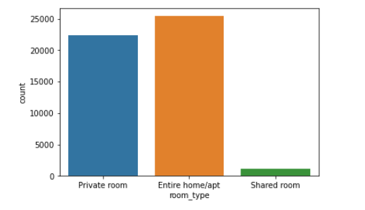
Exploratory Data Analysis.
Performed Exploratory data analysis on the dataset. First I wanted to see ,which rooms are in maximum use. From the figure we come to know that maximum people prefer Entire home/apt room and the second priority or choice was of private rooms. Very few people choose shared rooms.

Slide 4
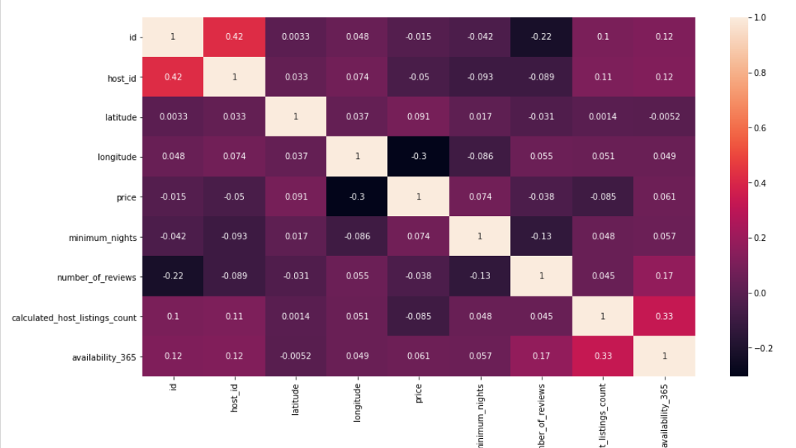
Correlation between Each variable.
From the correlation diagram we come to know,that there is a high correlation between availability_365 and calculated_host_listings_count.

Slide 5
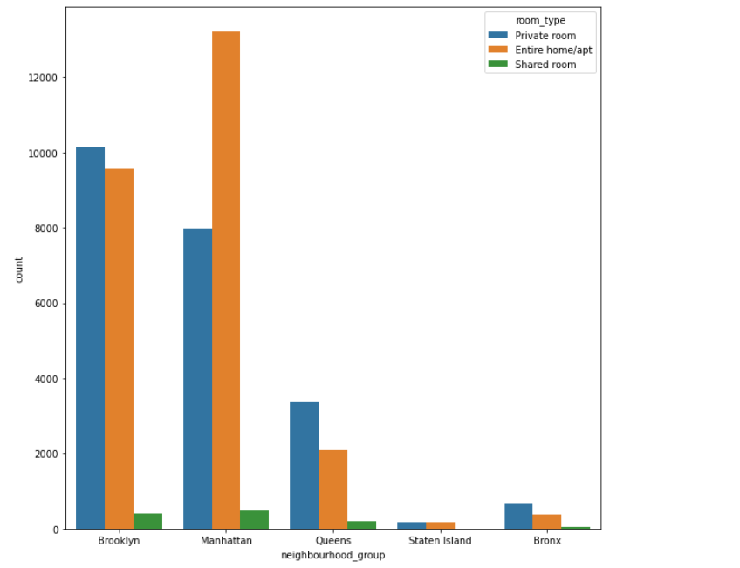
In which region was there maximum room bookings?
We find out that in Manhattan,there were maximum appartments which people preferred.And especially people preferred to have an Entire home for themselves.

Slide 6
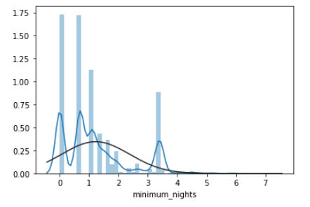
Predict Prices using Linear regression.
The prediction says that people book nights for an average of 2 nights.

Slide 7
Decision Tree Classifier.
Using the decision tree classifier, we get similar results and predictions. After calculating the error, I found out that to make predictions ,Multiple linear regression is most suitable for this dataset as its error value is lower.

